Slide 1



W A L M A R T S T O R E S A L E S A N A L Y S I S
SALES PERFORMANCE ANALYSIS OF WALMART STORES USING ADVANCED MYSQL
PRESENTED BY
DEVINA M VASUDEVAN

Slide 2
CONTENTS
INTRODUCTION
BUSINESS PROBLEM
TASK 1
TASK 4
TASK 5
TASK 6
TASK 7
TASK 8
TASK 9
TASK 10
ADDITIONAL INFO
INSIGHTS
CONCLUSION
RECOMMENDATION
LINKS

Slide 3
INTRODUCTION
Walmart is a major retail chain operating across multiple cities.
Dataset covers transactions with customer demographics, product lines, sales and payments.
Goal: Apply advanced SQL techniques to analyze the data.
Outcome: Generate actionable insights on sales, customer behavior, and operations.

Slide 4
BUSINESS PROBLEM
Walmart aims to optimize sales strategies using historical transaction data.
Analysis covers branches, customer types, payment methods, and product lines.
Advanced MySQL queries are applied for deeper exploration.
Focus: sales performance, customer segmentation, and product trends.

Slide 5
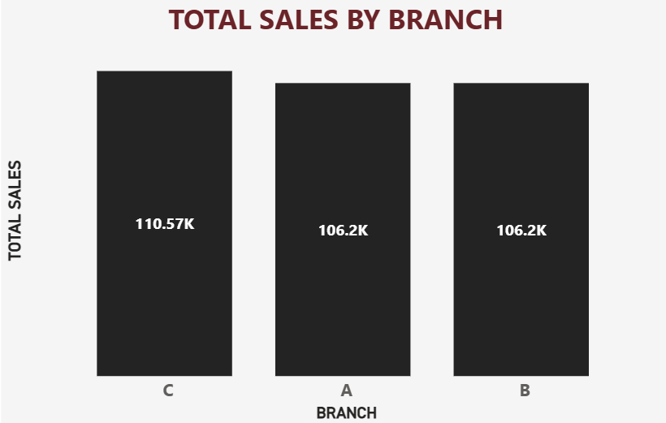
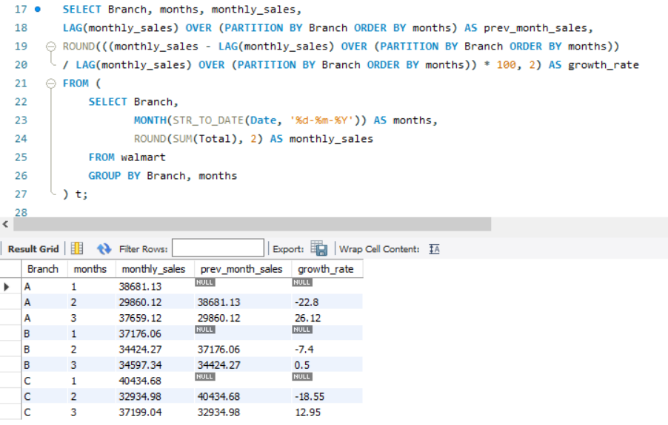
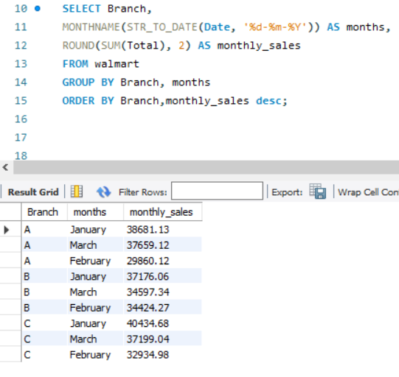
🛒 T A S K 1
IDENTIFYING THE TOP BRANCH BY SALES GROWTH RATE
INSIGHT: BRANCH C HAS STRONGEST GROWTH.
IMPROVEMENT: REPLICATE ITS STRATEGIES IN WEAKER BRANCHES.

Slide 6
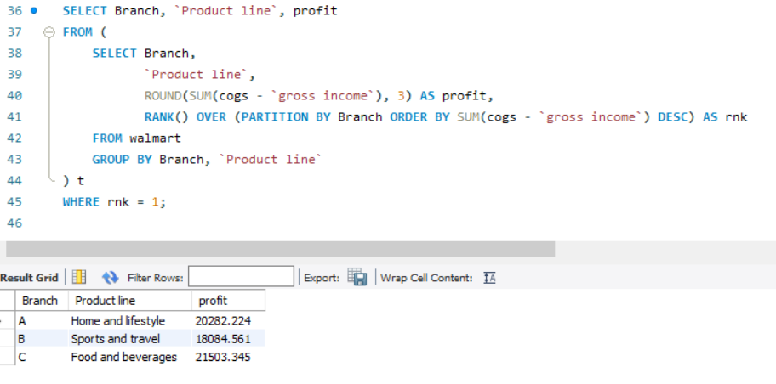
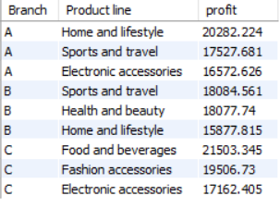
🛒 T A S K 2
FINDING THE MOST PROFITABLE PRODUCT LINE FOR EACH BRANCH
TOP 3 OF ALL BRANCHES
INSIGHT: FOOD & BEVERAGES AND SPORTS & TRAVEL LEAD IN PROFIT.
IMPROVEMENT: PROMOTE & CROSS-SELL THESE CATEGORIES.

Slide 7
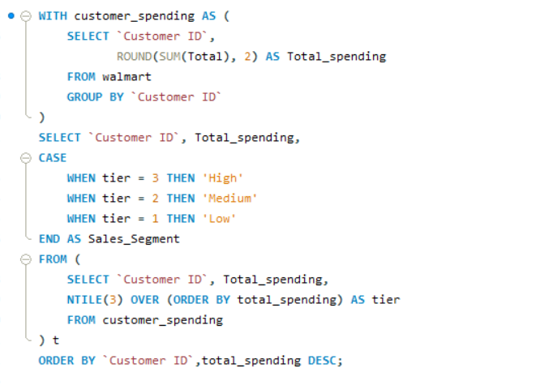
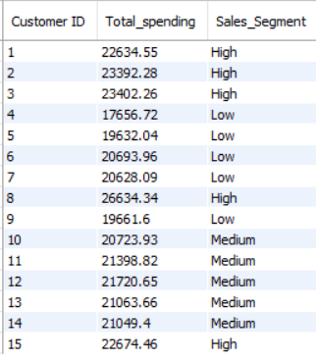
🛒 T A S K 3
ANALYZING CUSTOMER SEGMENTATION BASED ON SPENDING
INSIGHTS: REVENUE IS HEAVILY DEPENDENT ON TOP-TIER CUSTOMERS.
IMPROVEMENT: REWARD HIGH SPENDERS, LIFT LOWER TIERS WITH OFFERS.

Slide 8
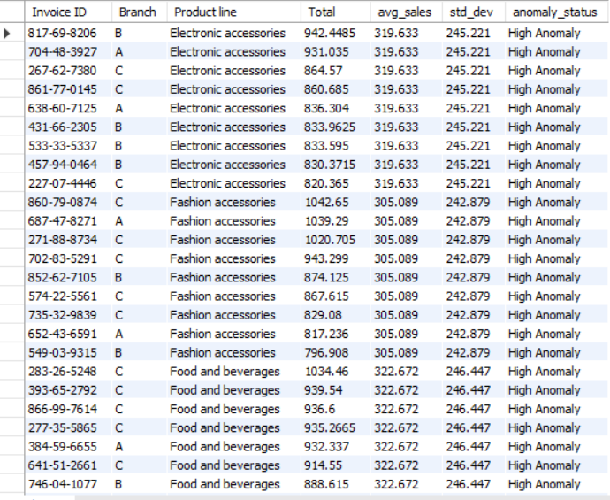
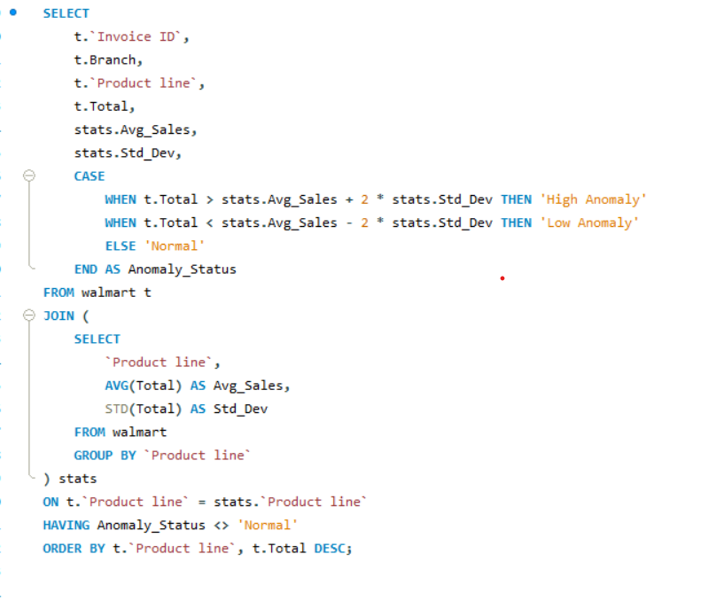
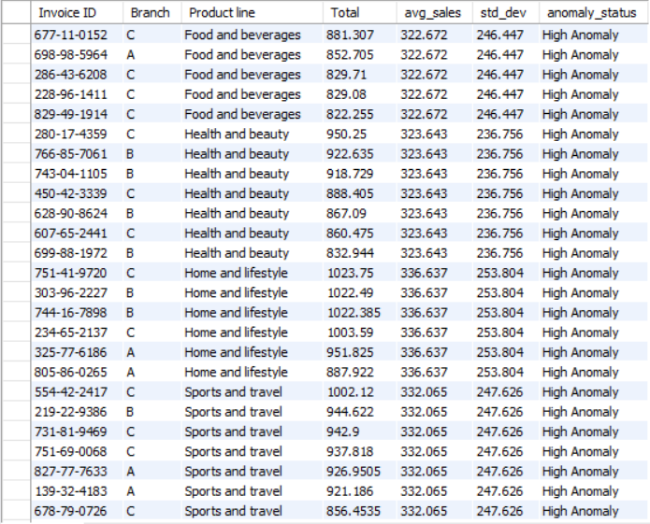
🛒 T A S K 4
DETECTING ANOMALIES IN SALES TRANSACTIONS
INSIGHTS: CERTAIN TRANSACTIONS FALL OUTSIDE NORMAL RANGES.
RECOMMENDATION: TRACK BULK ORDERS AND FLAG SUSPICIOUS ACTIVITY.

Slide 9
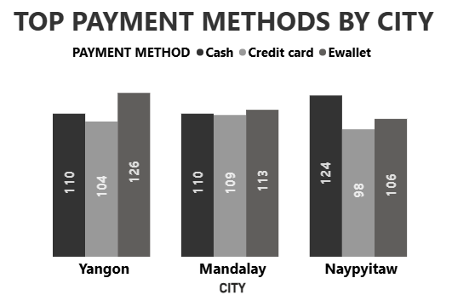
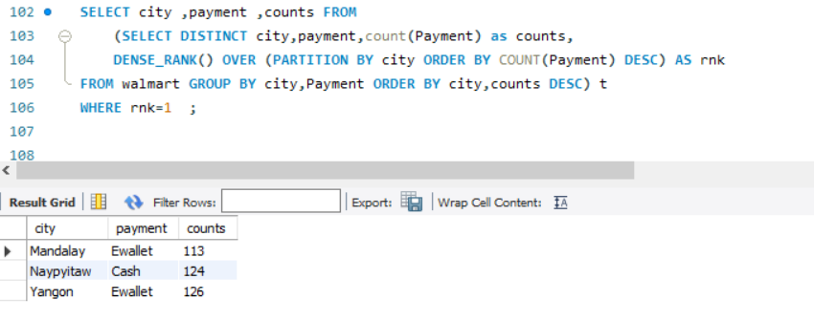
🛒 T A S K 5
MOST POPULAR PAYMENT METHOD BY CITY
INSIGHT: E-WALLETS DOMINATE IN YANGON, CASH IN NAYPYITAW.
IMPROVEMENT: RUN CITY-SPECIFIC PAYMENT OFFERS.

Slide 10
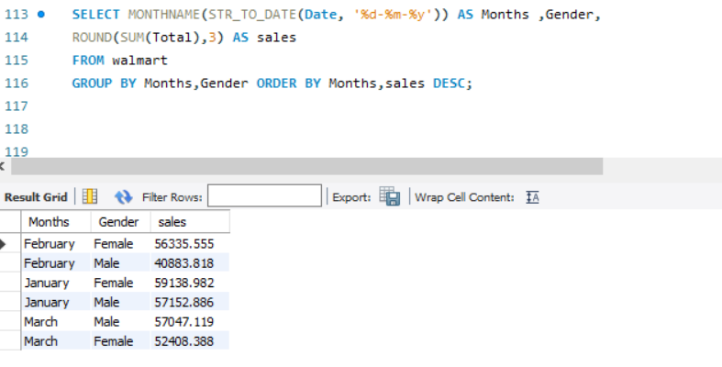
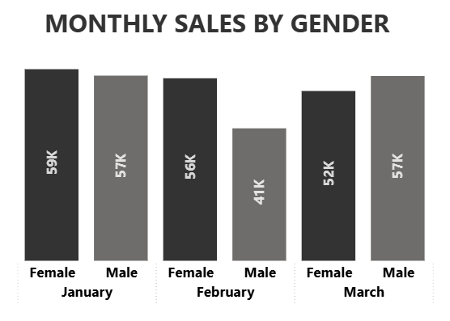
🛒 T A S K 6
MONTHLY SALES DISTRIBUTION BY GENDER
INSIGHT: SPENDING PATTERNS DIFFER BY GENDER MONTHLY.
IMPROVEMENT: SEASONAL CAMPAIGNS TAILORED TO GENDER.

Slide 11
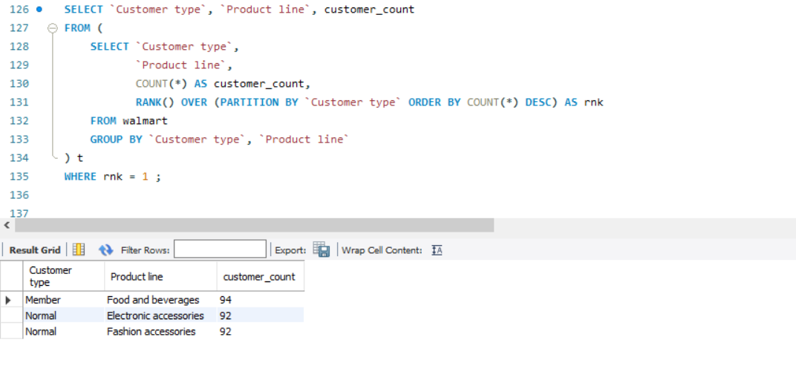
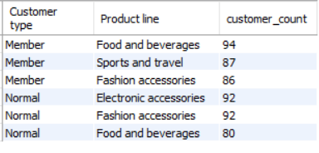
🛒 T A S K 7
BEST PRODUCT LINE BY CUSTOMER TYPE
TOP 3 PRODUCT LINE BY
CUSTOMER TYPE
INSIGHT: MEMBERS PREFER LIFESTYLE/ELECTRONICS; NORMALS PREFER ESSENTIALS.
IMPROVEMENT: PUSH MEMBERSHIPS VIA LIFESTYLE/ELECTRONICS OFFERS.

Slide 12
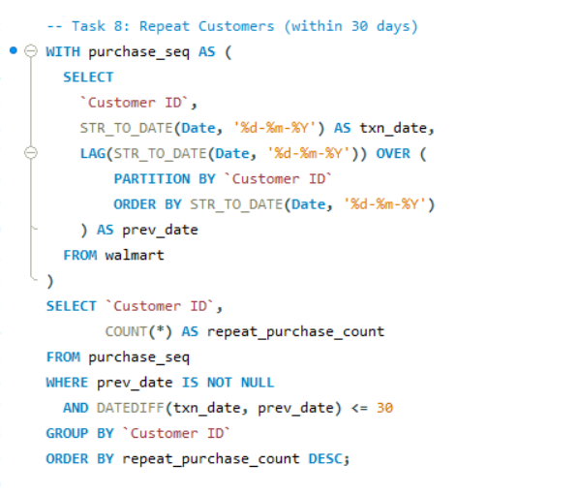
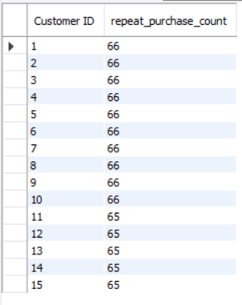
🛒 T A S K 8
IDENTIFYING REPEAT CUSTOMERS
INSIGHT: MANY CUSTOMERS REPURCHASE WITHIN 30 DAYS.
IMPROVEMENT: INTRODUCE 30-DAY LOYALTY/SUBSCRIPTION PLAN.

Slide 13
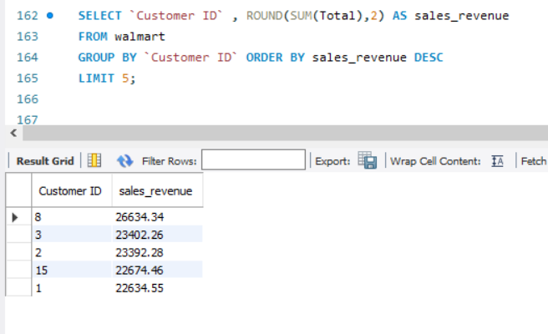
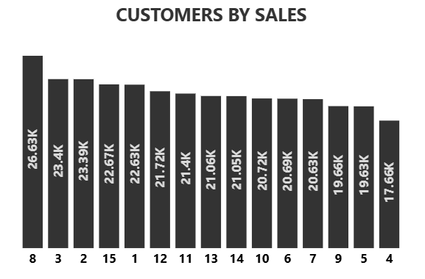
🛒 T A S K 9
FINDING TOP 5 CUSTOMERS BY SALES VOLUME
INSIGHT: FEW CUSTOMERS GENERATE BULK OF REVENUE.
IMPROVEMENT: REWARD TOP 5 WITH VIP PERKS.

Slide 14
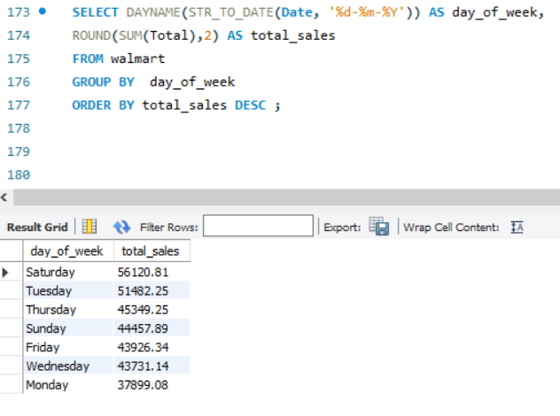
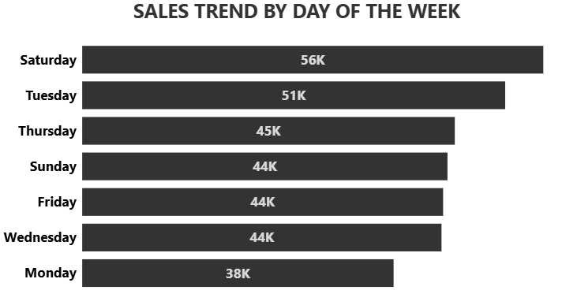
🛒 T A S K 10
ANALYZING SALES TRENDS BY DAY OF THE WEEK
INSIGHT: SATURDAY SHOWS THE HIGHEST SALES, WITH TUESDAY ALSO STRONG MIDWEEK; MONDAY IS THE WEAKEST.
RECOMMENDATION:BOOST MONDAY WITH REVENUE TARGETED FLASH DEALS & ENHANCE WEEKEND PERFORMANCE WITH COMBO OFFERS.

Slide 15
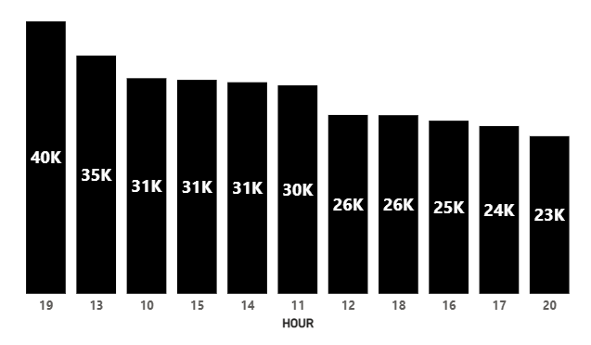
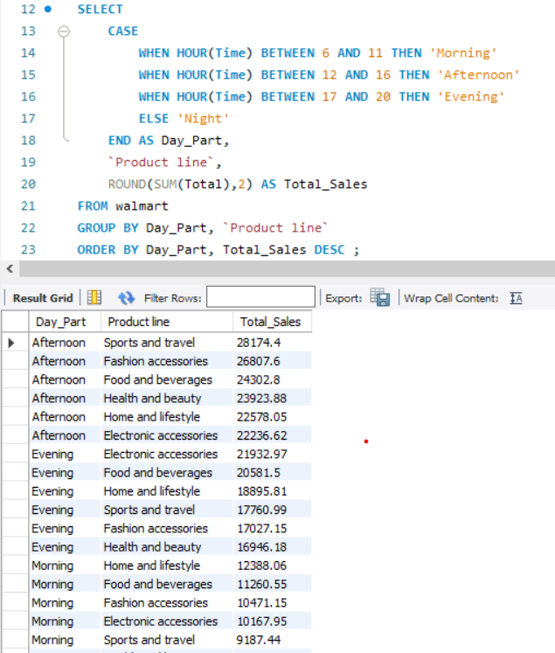
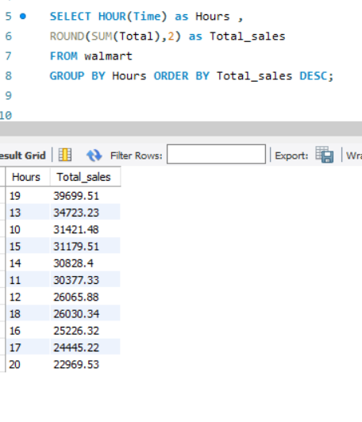
TOTAL SALES BY HOUR
TOTAL SALES BY DAY PART AND PRODUCT LINE
INSIGHTS:
Peak sales occur in the evening 7 pm and afternoon hours.
Morning sales remain consistently low across product lines.
RECOMMENDATION:
Focus flash promotions in evening and afternoon slots.
Introduce morning-special offers to lift early sales.

Slide 16
💡 KEY INSIGHTS
Branch C shows the fastest sales growth, while Branch A lags.
Food & Beverages and Sports & Travel are the most profitable product lines.
Revenue is heavily dependent on top-tier customers.
Payment method preference varies by city (E-Wallets in Yangon, Cash in Naypyitaw).
Gender influences monthly sales trends (males & females peak differently).
Repeat purchases within 30 days are common → strong loyalty.
Weekends (esp. Saturday) dominate sales, while Monday is weakest.

Slide 17
📊 CONCLUSION
Walmart’s growth is driven by certain branches and categories.
A small group of high-value customers contribute most revenue.
Shopping behavior differs across city, gender, customer type, and day of week.
Strong weekend sales highlight demand peaks, but weekdays need attention.
Repeat purchases show strong loyalty, but long-term retention still needs improvement.

Slide 18
🚀 RECOMMENDATION
Replicate Branch C’s successful strategies in weaker branches.
Promote profitable product lines and cross-sell with weaker categories
Introduce loyalty programs for high spenders and bundles for low spenders.
Design city-specific payment promotions (E-Wallet cashback in Yangon, Cash offers in Naypyitaw).
Encourage repeat buyers with 30-day loyalty/subscription schemes.
Run gender-targeted seasonal campaigns (cosmetics vs gadgets).
Launch Monday flash deals to tackle the weakest day and strengthen midweek promotions
Recognize and reward top 5 customers with exclusive VIP perks.

Slide 19
THANK YOU

Slide 20
LINK
FULL SQL SCRIPT : task_1-10_full_sql_script

